Slide 1
Naïve Bayes Classifier
Lab 4

Slide 2
Introduction to Naive Bayes
Naïve Bayes algorithm is a supervised learning algorithm, which is based on Bayes theorem and used for solving classification problems.
Also called as Idiot Bayes or Simple Bayes
The Naive Bayes classifier assumes that the presence of a feature in a class is not related to any other feature.
For example, a phone may be considered as smart if it is having touch screen, internet facility, good camera etc.
fast machine learning models that can make quick predictions
It is a probabilistic classifier, which means it predicts on the basis of the probability of an object.
Naive Bayes is a classification algorithm for binary and multi-class classification problems.
examples of Naïve Bayes Algorithm are spam filtration, Sentimental analysis, and classifying articles.

Slide 3
Why is it called Naïve Bayes?
Comprised of two words
Naïve: It is called Naïve because it assumes that the occurrence of a certain feature is independent of the occurrence of other features. Such as if the fruit is identified on the bases of color, shape, and taste, then red, spherical, and sweet fruit is recognized as an apple. (Even if these features depend on each other or upon the existence of the other features, all of these properties independently contribute to the probability that a particular fruit is an apple or an orange or a banana and that is why it is known as “Naive”. )
Hence each feature individually contributes to identify that it is an apple without depending on each other.
Bayes: It is called Bayes because it depends on the principle of Bayes' Theorem

Slide 4

Bayes' Theorem
Bayes’ theorem describes the probability of an event, based on prior knowledge of conditions that might be related to the event. It serves as a way to figure out conditional probability.
Bayes' theorem is also known as Bayes' Rule or Bayes' law, which is used to determine the probability of a hypothesis with prior knowledge. It depends on the conditional probability.
The formula for Bayes' theorem is given as:
Where,
P(A|B) is Posterior probability: Probability of hypothesis A on the observed event B.
P(B|A) is Likelihood probability: Probability of the evidence given that the probability of a hypothesis is true.
P(A) is Prior Probability: Probability of hypothesis before observing the evidence.
P(B) is Marginal Probability: Probability of Evidence.

Slide 5
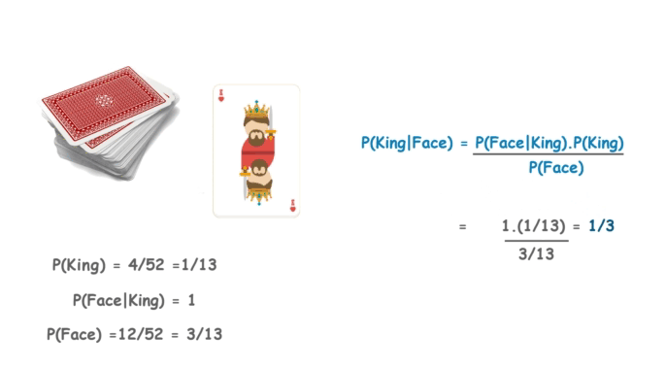
Let’s suppose we have a Deck of Cards, we wish to find out the “Probability of the Card we picked at random to be a King given that it is a Face Card“. So, according to Bayes Theorem, we can solve this problem. First, we need to find out the probability
P(King) which is 4/52 as there are 4 Kings in a Deck of Cards. (p(A)) (before picking the card)
P(Face|King) is equal to 1 as all the Kings are face Cards. (p(B|A))
P(Face) is equal to 12/52 as there are 3 Face Cards in a Suit of 13 cards and there are 4 Suits in total. (P(B))
P(A|B) is Posterior probability: Probability of hypothesis A on the observed event B.
P(B|A) is Likelihood probability: Probability of the evidence given that the probability of a hypothesis is true.
P(A) is Prior Probability: Probability of hypothesis before getting/observing the evidence
P(B) is Marginal Probability: Probability of Evidence.
P(class|data) = (P(data|class) * P(class)) / P(data)

Slide 6
Bayes theorem is used to find the probability of a hypothesis with given evidence.
In this, using Bayes theorem we can find the probability of A, given that B occurred. A is the hypothesis and B is the evidence.
P(B|A) is the probability of B given that A is True.
P(A) and P(B) is the independent probabilities of A and B.

Slide 7
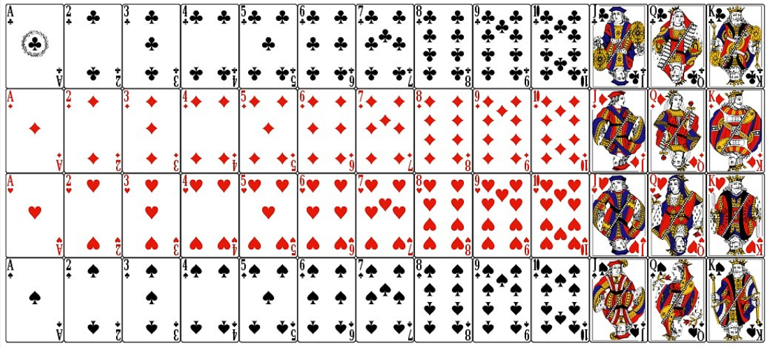

Slide 8
There are three types of Naive Bayes Model, which are given below:
Gaussian: The Gaussian model assumes that features follow a normal distribution. This means if predictors take continuous values instead of discrete, then the model assumes that these values are sampled from the Gaussian distribution.
Multinomial: The Multinomial Naïve Bayes classifier is used when the data is multinomial distributed. It is primarily used for document classification problems, it means a particular document belongs to which category such as Sports, Politics, education, etc. The classifier uses the frequency of words for the predictors.
Bernoulli: The Bernoulli classifier works similar to the Multinomial classifier, but the predictor variables are the independent Booleans variables. Such as if a particular word is present or not in a document. This model is also famous for document classification tasks.

Slide 9
Normal distribution, also known as the Gaussian distribution, is a probability distribution that is symmetric about the mean, showing that data near the mean are more frequent in occurrence than data far from the mean.

Slide 10
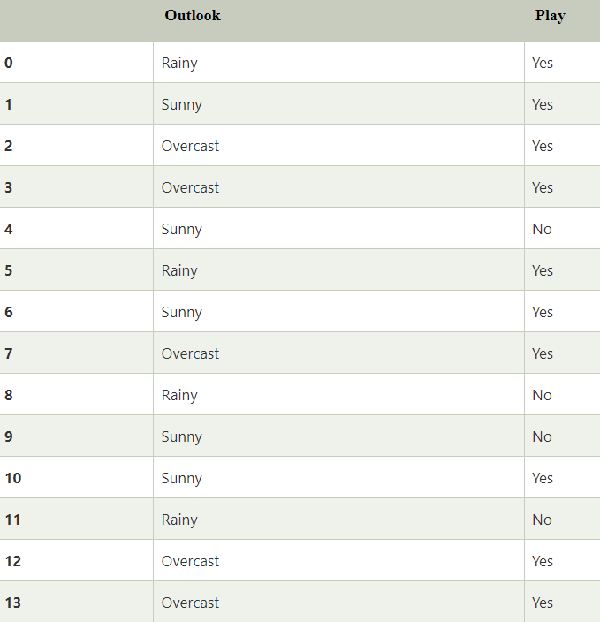

Slide 11
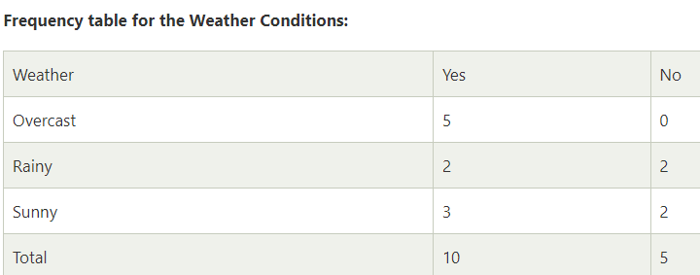
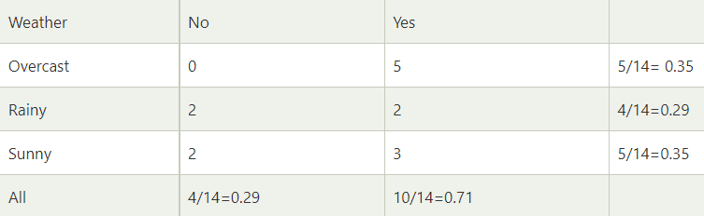
Applying Bayes'theorem:
P(Yes|Sunny)= P(Sunny|Yes)*P(Yes)/P(Sunny)
P(Sunny|Yes)= 3/10= 0.3
P(Sunny)= 0.35
P(Yes)=0.71
So P(Yes|Sunny) = 0.3*0.71/0.35= 0.60
The reverse is also true; for example:
P(B|A) = P(A|B) * P(B) / P(A)
P(No|Sunny)= P(Sunny|No)*P(No)/P(Sunny)
P(Sunny|NO)= 2/4=0.5
P(No)= 0.29
P(Sunny)= 0.35
So P(No|Sunny)= 0.5*0.29/0.35 = 0.41
So as we can see from the above calculation that
P(Yes|Sunny)>P(No|Sunny)
Hence on a Sunny day, Player can play the game.
Likelihood table weather condition:

